Slide 1
Welcome
My dear students of class seven.

Slide 2
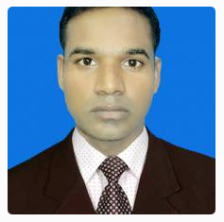
Identity
Teacher
Lesson
Class: Seven
Subject: English for Today
Unit: Four (People who make a difference)
Total Students: 58
Time: 40 minutes
Date: 20-05-2019
Md. Shorifuzzaman Siddique
Assistant Teacher (English)
Newashi Islamia Alim Madrasah,
Nageswari, Kurigram.

Slide 3
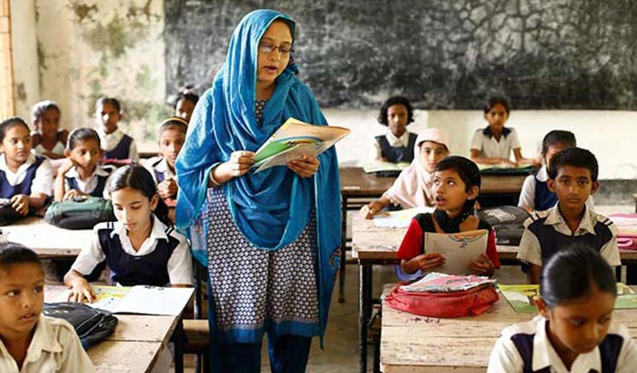
Let’s see some pictures…

Slide 4
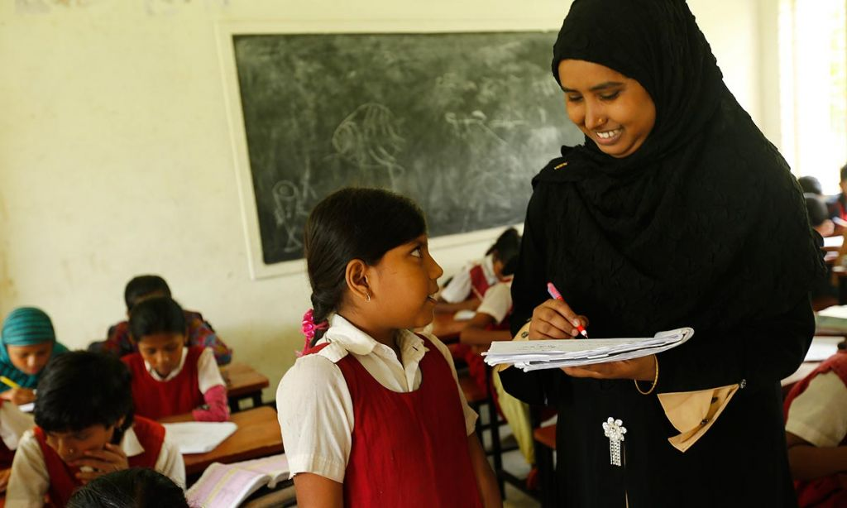
Let’s see some pictures…

Slide 5
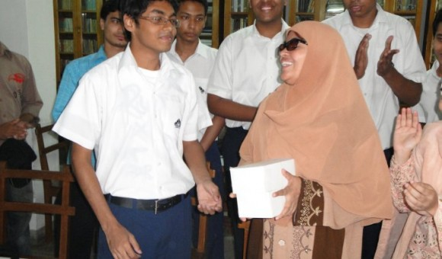
Let’s see some pictures…

Slide 6
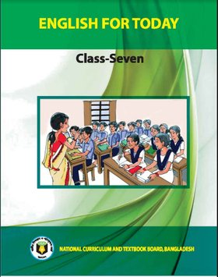
Today’s lesson is…
A teacher (2)

Slide 7
Learning Outcomes
After we have studied this unit, we will able to…
Can tell the meaning of the key words from the text.
Read and understand the text.
Ask and answer the questions.
Talk people, places and event.

Slide 8
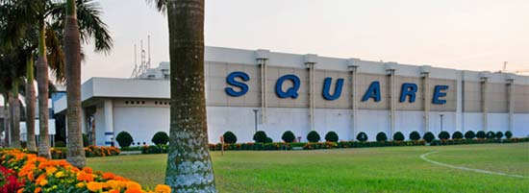
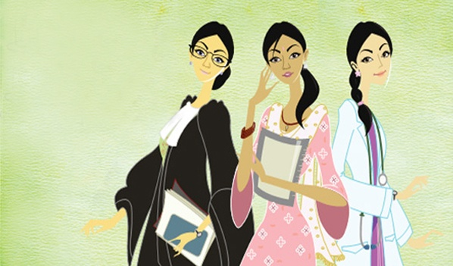
Key words of the text…
A commercial business
Company
Empty post
Vacant
relative social or professional position
Status

Slide 9
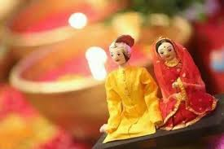
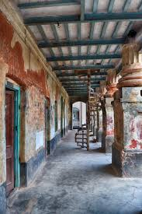
Key words of the text…
Admiration for someone because of their qualities or achievements
respect
In-low
a relative by marriage
corridor
a usually narrow passageway or route

Slide 10
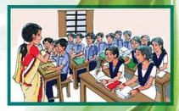
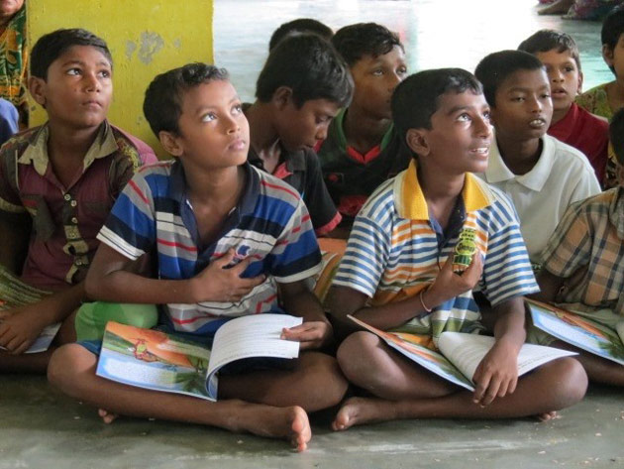
Key words of the text…
based on formal study especially at an institution of higher learning
academic
to feel respect and approval
admire
to influence, move, or guide
inspire

Slide 11
Read text silently about Ms Shahana Huda
5 minutes

Slide 12
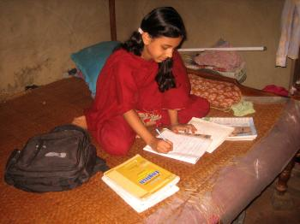
Single work- 5 min
Match the words with their meanings
Words | Meaning
 | a long narrow passage in a building
 | Relative by marriage especially husband’s
 | To show something by doing
 | Connected with study, education
 | To encourage somebody to do something well
 | High rank or social position
 | Bussiness
 | Empty (e.G. A seat not taken by anybody)
 | To show respect
company
vacant
Status
In- lows
Corridor
Academic
Admire
Demonstrate
Inspire

Slide 13
Let’s know something about the text…
Mr. Zamil Huda was an employee in a company office where has a vacant position and he wanted to join Shahana for the post.
Shahana was going to join in the local High Madrasah but her husband and other person of her family did not support her.
She joined the Madrasah against the will of the family.
She worked both in family and Madrasah.
Every day works hard to prepare his lessons.

Slide 14
Let’s know something about the text…
She helps both bright and weak students.
The student often come to her in the teacher’s room, in the corridor and even on the road to talk about any academic problem.
She gain popularity from students, teachers, Superintendent and other people of the locality.
One day her husband realized about shahana and he told her, “Teaching is more than a job”

Slide 15
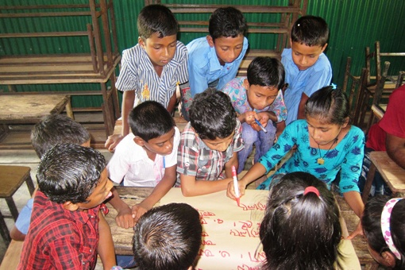
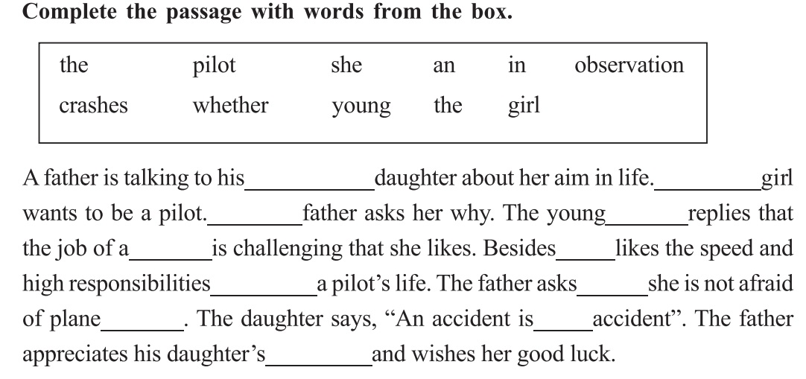
Group Work- 10 min
young
the
the
girl
pilot
she
in
whether
crashed
an
observation

Slide 16
Evaluation
Answer the following questions:
1. Who was Mr. Zamil Huda?
Ans: Mr. Zamil Huda is Shahana’s husband and is an employee in a company office.
2. What did Zamil Huda want?
Ans: Zamil Huda wanted that Shahana would join in his firm.
3. What is Shahana’s profession?
Ans: Ms Shahana is a teacher in a local High Madrasah.
4. Who respected to Shahana?
Ans: Shanana was respected by the students and gurdians, teachers, superintendent and other people of the locality.
5. How did Shahana become popular?
Ans: She worked both her family and institute. She helped both bright and weak students. She did not only teach her subject, she care for her students. She loved them. She herself demonstrate good behavior and inspire them to be good. That’s all she did.

Slide 17
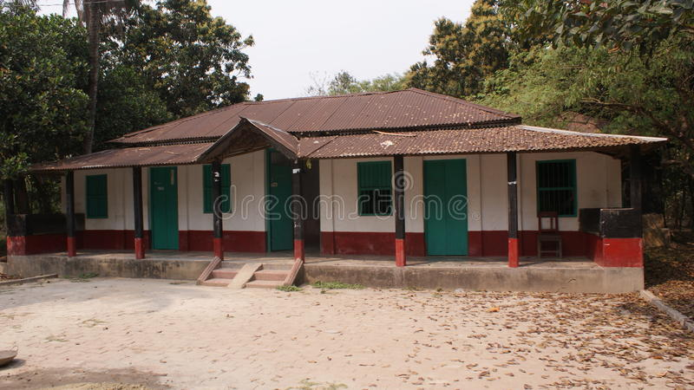
Home Work
Write a paragraph about ‘Your Favorite Teacher’ according to the text.

Slide 18
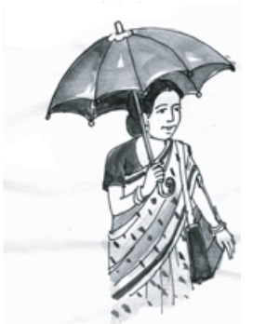
Thank you all

